Slide 1
ATM
by YUSUF KURT
YEDİTEPE UNIVERSITY
Computer Engineering Dept.

Slide 2
OUTLINE
Introduction to ATM
Principal Characteristics of ATM
Why ATM?
ATM Networks and Interfaces
How Does ATM Work?
ATM Protocol Architecture
Physical Layer
ATM Layer
ATM Adaptation Layer (AAL)
IP OVER ATM

Slide 3
WHAT’S ATM?
ATM is Asynchronous Transfer Mode.
ATM is a connection-oriented, high-speed, low-delay switching and transmission technology that uses short and fixed-size packets, called cells, to transport information.
ATM is originally the transfer mode for implementing Broadband ISDN (B-ISDN) but it is also implemented in non-ISDN environments where very high data rates are required

Slide 4
BROADBAND AND B-ISDN
Broadband:
"A service or system requiring transmission channel capable of
supporting rates greater than the primary rate.“
Broadband-Integrated Service Digital Network (B-ISDN):
A standard for transmitting voice, video and data at the same time over fiber optic telephone lines
The goal of B-ISDN is to accommodate all existing services along with those that will come in the future. The services that BISDN will support include
narrowband services, such as voice, voiceband data, facsimile, telemetry, videotex, electronic mail,
wideband services such as T1, and
broadband services such as video conference, high speed data, video on demand. BISDN is also to support point-to-point, point-to-multipoint and multipoint-to-multipoint connectivities.

Slide 5
ATM OVERVIEW
Used in both WAN and LAN settings
Signaling (connection setup) Protocol:
Packets are called cells (53 bytes)
  5-byte header + 48-byte payload
Commonly transmitted over SONET
  other physical layers possible
Connections can be switched (SVC), or permanent (PVC).
ATM operates on a best effort basis.
ATM guarantees that cells will not be disordered.
Two types of connections:
  Point-to-point
  Multipoint (Multicast)
Four Types of Services:
  CBR (Constant Bit Rate)
  VBR (Variable Bit Rate)
  ABR (Available Bit Rate) Flow Control, Rate-based, Credit- based
  UBR (Unspecific Bit Rate) No Flow control.

Slide 6
ATM Characteristics
No error protection or flow control on a link-by-link basis.
ATM operates in a connection-oriented mode.
The header functionality is reduced.
The information field length is relatively small and fixed.
All data types are the same

Slide 7
Why ATM?
International standard-based technology (for interoperability)
Low network latency (for voice, video, and real-time applications)
Low variance of delay (for voice and video transmission)
Guaranteed quality of service
High capacity switching (multi-giga bits per second)
Bandwidth flexibility (dynamically assigned to users)

Slide 8
Why ATM? (con’t)
Scalability (capacity may be increased on demand)
Medium not shared for ATM LAN (no degradation in performance as traffic load or number of users increases)
Supports a wide range of user access speeds
Appropriate (seamless integration) for LANs, MANs, and WANs
Supports audio, video, imagery, and data traffic (for integrated services)

Slide 9
ATM NETWORKS
Public ATM Network:
  Provided by public telecommunications carriers (e.g., AT&T, MCI WorldCom, and Sprint)
  Interconnects private ATM networks
  Interconnects remote non-ATM LANs
  Interconnects individual users
Private ATM Network:
  Owned by private organizations
  Interconnects low speed/shared medium LANs (e.g., Ethernet, Token Ring, FDDI) as a backbone network
  Interconnects individual users as the front-end LAN for high performance or multimedia applications

Slide 10
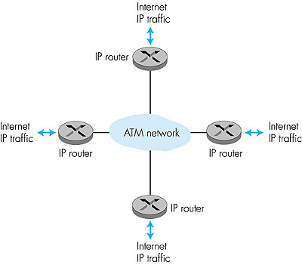
Switches in
the middle
End systems
of ATM

Slide 11

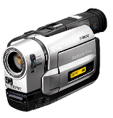





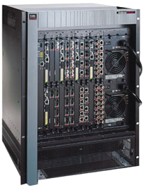
File
Server
Voice
FDDI
Ethernet
Video
Edge
Switch
PBX
Private
ATM
Network
Public
ATM Network
Mainframe
Computer
FDDI
Ethernet
Private
ATM
Switch
Edge
Switch
Edge
Switch
Token
Ring
Edge
Switch
Mainframe
Computer
PBX
FDDI
Token
Ring
Video
Ethernet
Video
Voice

Slide 12
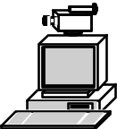
ATM Interfaces
Private
UNI
Public
UNI
P-NNI
Public
ATM Network
Private
ATM WAN
B-ICI
Private
ATM LAN
Public
ATM Network

Slide 13
How ATM Works?
ATM is connection-oriented -- an end-to-end connection must be established and routing tables setup prior to cell transmission
Once a connection is established, the ATM network will provide end-to-end Quality of Service (QoS) to the end users
All traffic, whether voice, video, image, or data is divided into 53-byte cells and routed in sequence across the ATM network
Routing information is carried in the header of each cell
Routing decisions and switching are performed by hardware in ATM switches
Cells are reassembled into voice, video, image, or data at the destination

Slide 14
User Applications
User Applications
Voice Video Data
Voice Video Data
BISDN
Services
BISDN
Services
Segmentation
Reassembly
Multiplexing
Demultiplexing
Workstation
Workstation
ATM Network
H
H
H
H
H
H
H
H
H
H
H
H
H
H

Slide 15
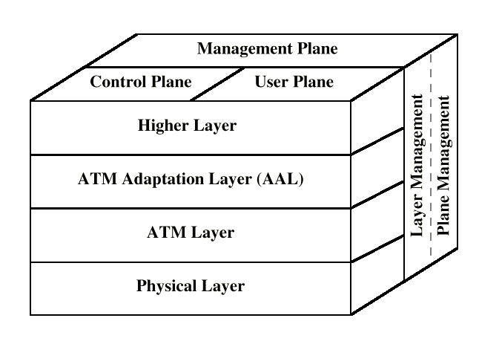
B-ISDN/ATM Protocol Reference Model
Source: Stallings: Data and Computer Communications

Slide 16
ATM Protocol Reference Model
Plane management functions
Higher layer
protocols &
functions
Signaling
& control
CONS data
CLNS data
Video
Voice
Adaptation
layer
Convergence
CBR
SAR
Transfer mode
ATM
Access control
Physical Layer

Slide 17
ATM Protocol Reference Model
Plane management functions
Higher layer
protocols &
functions
Signaling
& control
CONS data
CLNS data
Video
Voice
Adaptation
layer
Convergence
CBR
SAR
Transfer mode
ATM
Access control
Physical Layer

Slide 18
ATM Protocol Reference Model
Plane management functions
Higher layer
protocols &
functions
Signaling
& control
CONS data
CLNS data
Video
Voice
Adaptation
layer
Convergence
CBR
SAR
Transfer mode
ATM
Access control
Physical Layer

Slide 19
ATM Protocol Reference Model
Plane management functions
Higher layer
protocols &
functions
Signaling
& control
CONS data
CLNS data
Video
Voice
Adaptation
layer
Convergence
CBR
SAR
Transfer mode
ATM
Access control
Physical Layer

Slide 20
ATM Protocol Reference Model
Plane management functions
Higher layer
protocols &
functions
Signaling
& control
CONS data
CLNS data
Video
Voice
Adaptation
layer
Convergence
CBR
SAR
Transfer mode
ATM
Access control
Physical Layer

Slide 21
ATM Protocol Reference Model
Plane management functions
Higher layer
protocols &
functions
Signaling
& control
CONS data
CLNS data
Video
Voice
Adaptation
layer
Convergence
CBR
SAR
Transfer mode
ATM
Access control
Physical Layer

Slide 22
ATM Protocol Reference Model
Plane management functions
Higher layer
protocols &
functions
Signaling
& control
CONS data
CLNS data
Video
Voice
Adaptation
layer
Convergence
CBR
SAR
Transfer mode
ATM
Access control
Physical Layer

Slide 23
ATM Protocol Reference Model
Plane management functions
Higher layer
protocols &
functions
Signaling
& control
CONS data
CLNS data
Video
Voice
Adaptation
layer
Convergence
CBR
SAR
Transfer mode
ATM
Access control
Physical Layer

Slide 24
ATM Protocol Reference Model
Plane management functions
Higher layer
protocols &
functions
Signaling
& control
CONS data
CLNS data
Video
Voice
Adaptation
layer
Convergence
CBR
SAR
Transfer mode
ATM
Access control
Physical Layer

Slide 25
ATM Protocol Reference Model
Plane management functions
Higher layer
protocols &
functions
Signaling
& control
CONS data
CLNS data
Video
Voice
Adaptation
layer
Convergence
CBR
SAR
Transfer mode
ATM
Access control
Physical Layer

Slide 26
ATM Protocol Reference Model
Plane management functions
Higher layer
protocols &
functions
Signaling
& control
CONS data
CLNS data
Video
Voice
Adaptation
layer
Convergence
CBR
SAR
Transfer mode
ATM
Access control
Physical Layer

Slide 27
ATM Protocol Reference Model
Plane management functions
Higher layer
protocols &
functions
Signaling
& control
CONS data
CLNS data
Video
Voice
Adaptation
layer
Convergence
CBR
SAR
Transfer mode
ATM
Access control
Physical Layer

Slide 28
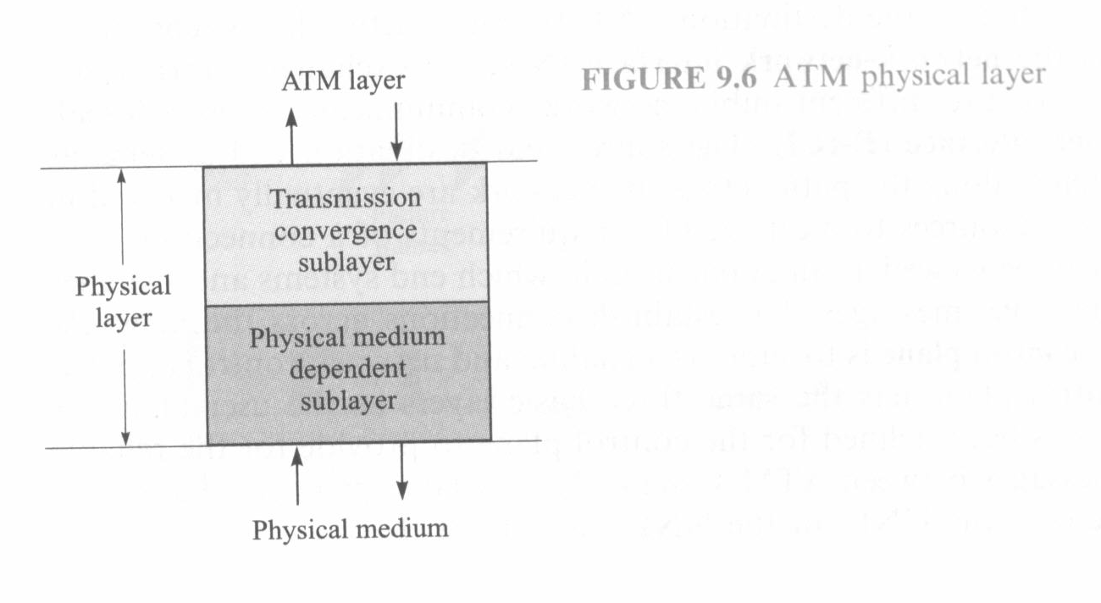
ATM Physical Layer

Slide 29
TCS
  Transmission Convergence Sublayer (TCS): adapts ATM layer above to PMD sublayer below
  Header checksum generation: 8 bits CRC
  Cell delineation
  With “unstructured” PMD sublayer, transmission of idle cells when no data cells to send

Slide 30
Physical Medium Dependent sublayer
Physical Medium Dependent Sublayer: depends on physical medium being used
SONET/SDH: (Synchronous Optical Network / Synchronous Digital Hierarchy) transmission frame structure (like a container carrying bits);
  bit synchronization;
  bandwidth partitions (TDM);
  several speeds: OC3 = 155.52 Mbps; OC12 = 622.08 Mbps; OC48 = 2.45 Gbps, OC192 = 9.6 Gbps
TI/T3: transmission frame structure (old telephone hierarchy): 1.5 Mbps/ 45 Mbps
unstructured: just cells (busy/idle)

Slide 31
ATM LAYER
The ATM layer provides for the transparent transport of fixed sized ATM layer service data units between communicating upper layer entities (e.g., ATM Adaptation Layer).
An interface between the AAL and the physical layer

Slide 32
ATM CELL
5-byte ATM cell header
48-byte payload
  Why?: small payload -> short cell-creation delay for digitized voice
5 Bytes
48 Bytes
Header
Payload
Leon-Garcia & Widjaja: Communication Networks

Slide 33
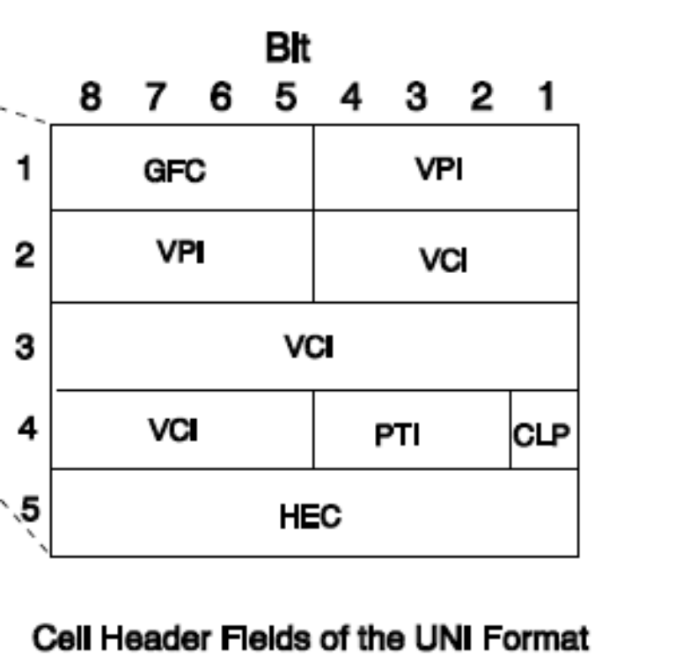
ATM CELL HEADER FORMAT (UNI)
GFC: Generic Flow Control
VPI: Virtual Path Identifier
VCI: Virtual Circuit Identifier
PTI: Payload Type Indicator
CLP: Cell Loss Priority
HEC: Header Error Control

Slide 34
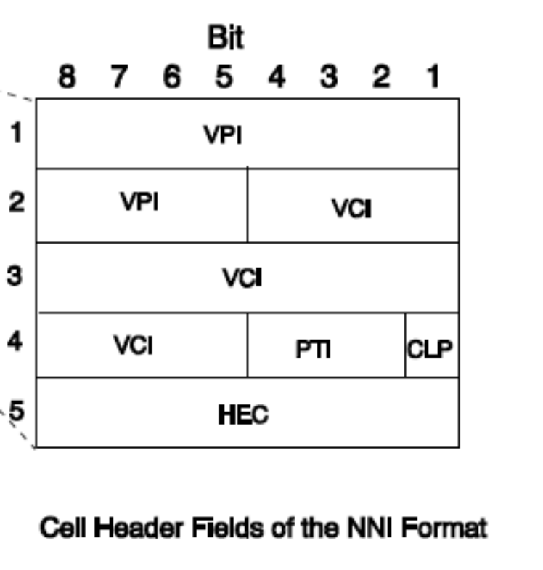
ATM CELL HEADER FORMAT (NNI)
VPI: Virtual Path Identifier
VCI: Virtual Circuit Identifier
PTI: Payload Type Indicator
CLP: Cell Loss Priority
HEC: Header Error Control

Slide 35
ATM SERVICES
Service: transport cells across ATM network
analogous to IP network layer
very different services than IP network layer
Network
Architecture
Internet
ATM
ATM
ATM
ATM
Service
Model
best effort
CBR
VBR
ABR
UBR
Guarantees ?
Congestion
feedback
no (inferred
via loss)
no
congestion
no
congestion
yes
no
Bandwidth
none
constant
rate
guaranteed
rate
guaranteed
minimum
none
Loss
no
yes
yes
no
no
Order
no
yes
yes
yes
yes
Timing
no
yes
yes
no
no

Slide 36
ATM VIRTUAL CIRCUITS
VC transport: cells carried on VC from source to destination
  call setup, teardown for each call before data can flow
  each packet carries VC identifier (not destination ID)
  every switch on source-dest path maintain “state” for each passing connection
  link,switch resources (bandwidth, buffers) may be allocated to VC: to get circuit-like perf.
Permanent VCs (PVCs)
  long lasting connections
  typically: “permanent” route between to IP routers
Switched VCs (SVC):
  dynamically set up on per-call basis

Slide 37
Virtual Channels
The virtual channel (VC) is the fundamental unit of transport in a B-ISDN. Each ATM cell contains an explicit label in its header to identify the virtual channel.
  a Virtual Channel Identifier (VCI)
  a Virtual Path Identifier (VPI)
A virtual channel (VC) is a communication channel that provides for the transport of ATM cells between two or more endpoints for information transfer.
A Virtual Channel Identifier (VCI) identifies a particular VC within a particular VP over a UNI or NNI.
A specific value of VCI has no end-to-end meaning.

Slide 38
Virtual Paths
A Virtual Path (VP) is a group of Virtual Channels that are carried on the same physical facility and share the same Virtual Path Identifier (VPI) value.
The VP boundaries are delimited by Virtual Path Terminators (VPT).
AT VPTs, both VPI and VCI are processed.
Between VPTs associated with the same VP, only the VPI values are processed (and translated) at ATM network elements.
The VCI values are processed only at VPTs, and are not translated at intermediate ATM network elements.

Slide 39
ATM Virtual Connections
Virtual Paths
Physical Link
Virtual Channels
Copyright ©2000 The McGraw Hill Companies

Slide 40
ATM Layer Functions
Cell multiplexing and switching
Cell rate decoupling
Cell discrimination based on pre-defined VPI/VCI
Quality of Service (QoS)
Payload type characterization
Generic flow control
Loss priority indication and Selective cell discarding
Traffic shaping

Slide 41
ATM ADAPTATION LAYER (AAL)
“adapts” upper layers (IP or native ATM applications) to ATM layer below
AAL exists only in end systems, not in switches
AAL layer segment (header/trailer fields, data) fragmented across multiple ATM cells
AAL Services
  Handle transmission errors
  Segmentation/reassembly (SAR)
  Handle lost and misinserted cell conditions
  Flow control and timing control

Slide 42
User information
User information
AAL
AAL
ATM
ATM
ATM
ATM
PHY
PHY
PHY
PHY
…
End system
Network
End system
Copyright ©2000 The McGraw Hill Companies

Slide 43
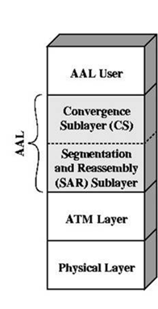
AAL SUBLAYERS
AAL layer has 2 sublayers:
  Convergence Sublayer (CS)
    Supports specific applications using AAL
    manages the flow of data to and
    from SAR sublayer
    Timing and cell loss recovery
  Segmentation and Reassembly Layer (SAR)
    Packages data from CS into cells and
    unpacks at other end

Slide 44
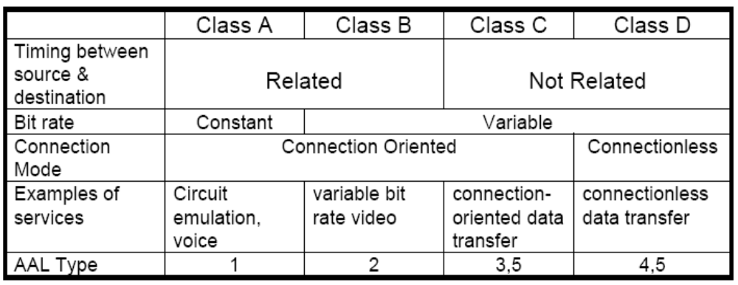
ATM ADAPTATION LAYER (AAL)
SERVICE CLASSES AND AAL TYPES

Slide 45
AAL 1 (Constant Bit Rate) Functions
Constant-bit-rate source
SAR simply packs bits into cells and unpacks them at destination
Emulation of DS1 and DS3 Circuits
Distribution with forward error correction
Handle cell delay for constant bit rate
Transfer timing information between source and destination
Transfer structure information (structure pointer)
Provide indication of unrecoverable lost or errored information
SAR PDU
Header SN SNP 47 Octets Payload
Seq
CRC
CSI
EP
Count
1 3 3 1

Slide 46
AAL 2 Protocol Data Unit (PDU)
ATM PDU
SAR PDU
Header SN IT 47 Octets Payload LI CRC
SN: Sequence number
IT: Information Type:BOM,COM,EOM,SSM
Length Indicator
    BOM: beginning of message
    COM: continuation of message
    EOM end of message

Slide 47
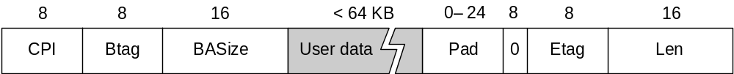
AAL 3/4
Convergence Sublayer Protocol Data Unit (CS-PDU)
  CPI: commerce part indicator (version field)
  Btag/Etag:beginning and ending tag
  BAsize: hint on amount of buffer space to allocate
  Length: size of whole PDU

Slide 48
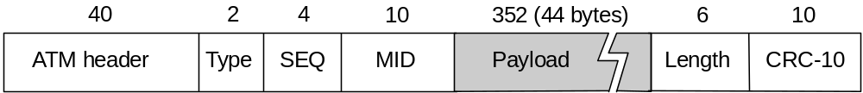
Cell Format
  Type
    BOM: beginning of message
    COM: continuation of message
    EOM end of message
  SEQ: sequence of number
  MID: message id
  Length: number of bytes of PDU in this cell

Slide 49
AAL 3/4
Higher layer
Information
User message
Service specific convergence sublayer
Assume null
Common part convergence sublayer
Pad message to multiple of 4 bytes. Add header and trailer.
H
Information
PAD
T
4
4
SAR sublayer
…
Each SAR-PDU consists of 2-byte header, 2-byte trailer, and 44-byte payload.
2 44 2
2 44 2
2 44 2
ATM layer
…
Copyright ©2000 The McGraw Hill Companies

Slide 50
AAL 5 PDU Structure
is used to transport IP datagrams over ATM networks.
The Simple and Efficient Adaptation Layer (SEAL), attempts to reduce the complexity and overhead of AAL 3/4.
It eliminates most of the overhead of AAL 3/4.
AAL 5 comprises a convergence sublayer and a SAR sublayer, although the SAR is essentially null.
Streamlined transport for connection oriented protocols
  Reduce protocol processing overhead
  Reduce transmission overhead
  Ensure adaptability to existing transport protocols

Slide 51
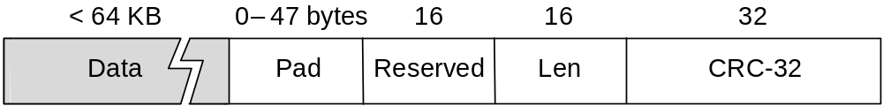
AAL5
CS-PDU Format
  pad so trailer always falls at end of ATM cell
  Length: size of PDU (data only)
  CRC-32 (detects missing or misordered cells)
Cell Format
  end-of-PDU bit in Type field of ATM header

Slide 52
AAL 5
Higher layer
Information
Service specific convergence sublayer
Assume null
Common part convergence sublayer
Information
PAD
T
SAR sublayer
…
48 (0)
48 (0)
48 (1)
Figure 9.18
ATM layer
…
Copyright ©2000 The McGraw Hill Companies
PTI = 1
PTI = 0
PTI = 0
Leon-Garcia & Widjaja: Communication Networks

Slide 53

IP-Over-ATM
Issues:
IP datagrams into ATM AAL5 PDUs
from IP addresses to ATM addresses
  just like IP addresses to 802.3 MAC addresses!
ATM
network
Ethernet
LANs

Slide 54
Datagram Journey in IP-over-ATM Network
at Source Host:
  IP layer maps between IP, ATM dest address (using ARP)
  passes datagram to AAL5
  AAL5 encapsulates data, segments data into cells, passes to ATM layer
ATM network: moves cell along VC to destination
at Destination Host:
  AAL5 reassembles cells into original datagram
  if CRC OK, datagram is passed to IP

Slide 55
END

